Slide 1
Ansible Fundamentals
Michael Richardson - Consulting Engineer
Notes:
Hi, my name is Michael Richardson. I’m an Automation Consulting Engineer, and this is a presentation on Ansible Fundamentals.

Slide 2
Agenda
Ansible: Introduction and Purpose
Ansible Concepts
Using Ansible with PAN-OS
Notes:
I’m going to take you through:
A bit of background about Ansible and why customers use it
Basic concepts you’ll need to know when working with Ansible
How to use the PAN-OS Ansible modules, and the value they have for customers and SEs.

Slide 3
Ansible Introduction
Notes:
First, a quick introduction to Ansible.

Slide 4

Ansible Introduction
https://www.ansible.com
Infrastructure management tool
Open source
Developed by RedHat
Notes:
Ansible is an open source infrastructure management tool, which encompasses software provisioning, configuration management, and application deployment.
It runs on many UNIX-like systems, as well as Windows.
It’s developed by RedHat.

Slide 5
Why Ansible?
Manual changes are slow and error prone
Changes are not always documented
Replicating configuration is difficult and time consuming
Increasing deployment scale or speed magnifies these problems
Notes:
The fundamental problem that Ansible and other configuration management software addresses is the elimination of manual changes to a controlled system.
For decades now, engineers have managed systems by connecting directly to the system and making changes that may or may not ultimately be documented. If you ever needed to replicate that configuration to recover from a failure or to have a copy of that system to test, doing it manually is a very difficult and time consuming process. This is problematic for even a single system - your customers can have environments with 100s of thousands of servers, so they really need a tool to assist with the management of these systems at scale. Couple that with a modern development environment where whole applications are being built and torn down automatically for testing purposes, and you can see where a tool like Ansible fits in.

Slide 6
Ansible
Simple
No special coding skills required
Clear human readable syntax (YAML)
Easy to use
Control machine needs Python and associated modules
Managed devices need OpenSSH/WinRM/HTTP API - no agents required
Built-in modules for many common tasks
Powerful - merges capabilities of other types of tools together
Configuration management: Puppet, Chef, cfengine
Server deployment: Capistrano, Fabric
Task execution: Func, plain SSH
Notes:
Ansible was developed to be simple and easy to use, but still powerful enough to cover a lot of different use cases.
It doesn’t require any sort of special coding skills. Configuration is written in plain text using YAML, and is designed to be understandable by someone who hasn’t ever seen it before.
The required control infrastructure is minimal. The control machine needs Python and any other libraries you want to leverage. Devices are managed through OpenSSH, WinRM, or an HTTP API and don’t require an agent. This is important because many other configuration management tools (Puppet, Chef, SaltStack) require or really want agents. Since we can’t add an agent on the firewall, we can’t integrate with them.
Ansible ships with many built in modules for common tasks. This makes it easy to get started without actually having to learn Python or APIs, ours included.
You can do many things with Ansible that previously required different tools. Configuration management, server deployment, and ad-hoc task execution are all things you can do with Ansible.

Slide 7
Ansible Concepts
Notes:
Now let’s go through some basic concepts you will need to know when working with Ansible.

Slide 8
Ansible Concepts: Inventory
List of machines to manage
Can be organized into groups, have variables assigned to them
Can be static or dynamic
Notes:
The first thing you’ll have to know about is the inventory.
This is simply just a list of managed machines.
The inventory can be organized into groups, so you can have a number of machines in the same group that get deployed the same way, and these individual machines or groups can have variables assigned to them.
Inventories can be statically defined, or can be dynamic. Dynamic inventories can be built on the fly by talking to some external system (VMware, Openstack, AWS, etc).

Slide 9
Sample Inventory
[atlanta]
host1
host2
[raleigh]
host2
host3
[southeast:children]
atlanta
raleigh
[southeast:vars]
some_server=foo.southeast.example.com
halon_system_timeout=30
self_destruct_countdown=60
escape_pods=2
Notes:
Here’s an example of a static inventory file. Atlanta and Raleigh are both groups with two hosts each, Southeast is a group containing the hosts in Atlanta and Raleigh, and we’re assigning some variables specific to the Southeast group.

Slide 10
Ansible Concepts: Modules
Piece of code to accomplish a specific task (UNIX philosophy)
Installing software, editing files, restarting services, etc.
Most frequently written in Python (but doesn’t have to be)
Modules frequently interact with a remote system over SSH
Ansible comes with a LOT of built in modules
https://docs.ansible.com/ansible/latest/modules/modules_by_category.html
Good modules are idempotent
Modules check to see if the configuration they’re changing needs it first
Only change configuration if needed
Notes:
The next thing you’ll need to know about are modules.
Modules are a piece of code to accomplish a specific task, such as installing software, editing files, restarting services, and so on. They are most frequently written in Python, but you can use other languages as well.
They typically SSH to a host and run some Python code. I’m making this distinction because the PAN-OS Ansible modules do NOT do this, they use the API instead.
Ansible comes with a lot of built in modules, so it is really easy to get started without writing code yourself.
Good modules are idempotent, which basically means they check to see if the configuration they’re supposed to be changing needs it first. If the configuration doesn’t need changing, they return “ok” instead of “changed”, so you can also use this as a check to see if a machine is correctly configured.

Slide 11
Sample Module Call
- name: Upgrade all installed packages to latest version
apt: upgrade=dist update_cache=yes
tags: [ provision_os, update_packages ]
Notes:
Here’s a simple example of a module call. It’s using apt on a Debian based Linux system to upgrade all the installed packages. You can also assign tags to module calls in case you want to run a subset of them later.

Slide 12
Ansible Concepts: Playbooks
Sequence of module calls (tasks) that you run in sequence
Notes:
Next are playbooks. Playbooks are just a sequence of module calls, referred to as tasks, that you run in a sequence. For example, I have an Ansible playbook that provisions a base Ubuntu build.

Slide 13
Sample Playbook
- name: Upgrade all installed packages to latest version
apt: upgrade=dist update_cache=yes
tags: [ provision_os, update_packages ]
- name: Install NTP
apt: name=ntp state=present
tags: [ provision_os, ntp ]
- name: Be sure NTP is running and enabled
service: name=ntp state=started enabled=yes
tags: [ provision_os, ntp ]
- name: Remove old downloaded packages
apt: autoclean=yes autoremove=yes
tags: [ provision_os, update_packages ]
Notes:
Here’s what that playbook looks like.
I upgrade all the installed packages (which was our module call example).
Make sure NTP is installed, started and enabled.
Then I clean up and remove any old packages.

Slide 14
Ansible Concepts: Variables
Can be defined within a playbook, external files, or passed in via CLI.
Sensitive variables can be encrypted using ansible-vault.
In module calls, anything inside {{ }} is a variable name.
Make sure to wrap within quotes when using
Notes:
Next are variables.
These can be defined directly within a playbook, split out into external vars files, or specified on the command line.
Sensitive variables like passwords or API keys can be encrypted using ansible-vault, which is really important to remember especially if you’re using a public source code repository like GitHub.
Variables are wrapped in curly braces inside module calls. Make sure to use quotes when you want the value of that variable.

Slide 15
Sample Variable Definition
vars:
ansible_tower_version: "latest"
ansible_tower_dir: /tmp/ansible-tower-setup
vars_files:
- vars/fw_secrets.yml
Notes:
Here’s some quick examples of specifying variables directly in a playbook, and also how you would reference an external file.

Slide 16
Using Variables
- name: Force apt key retrieval to port 80
lineinfile:
path: "{{ ansible_tower_dir }}/roles/packages_ubuntu/vars/Ubuntu-16.04.yml"
regexp: " keyserver: 'hkps.pool.sks-keyservers.net'"
line: " keyserver: 'hkp://hkps.pool.sks-keyservers.net:80'"
Notes:
Here’s how variables can be used in a module call. We’re using the lineinfile module to change a specific file. The variable “ansible_tower_dir” is going to be replaced with the value on the previous slide, /tmp/ansible-tower-setup.

Slide 17
Ansible Concepts: Roles
Packages of variable files, modules, playbooks, etc. that can be reused and shared
Commonly associated with a specific software package or higher level task
Set up MySQL, Jenkins, ELK
Ansible Galaxy: https://galaxy.ansible.com
Great for building lab machines!
Notes:
Roles are packages of variable files, modules, and playbooks that can be reused and shared. You could package together the playbooks to set up a web server, or some other software application together in a role.
Ansible Galaxy is a publicly accessible repository of roles that anyone can contribute to. It’s a great resource for building lab machines!

Slide 18
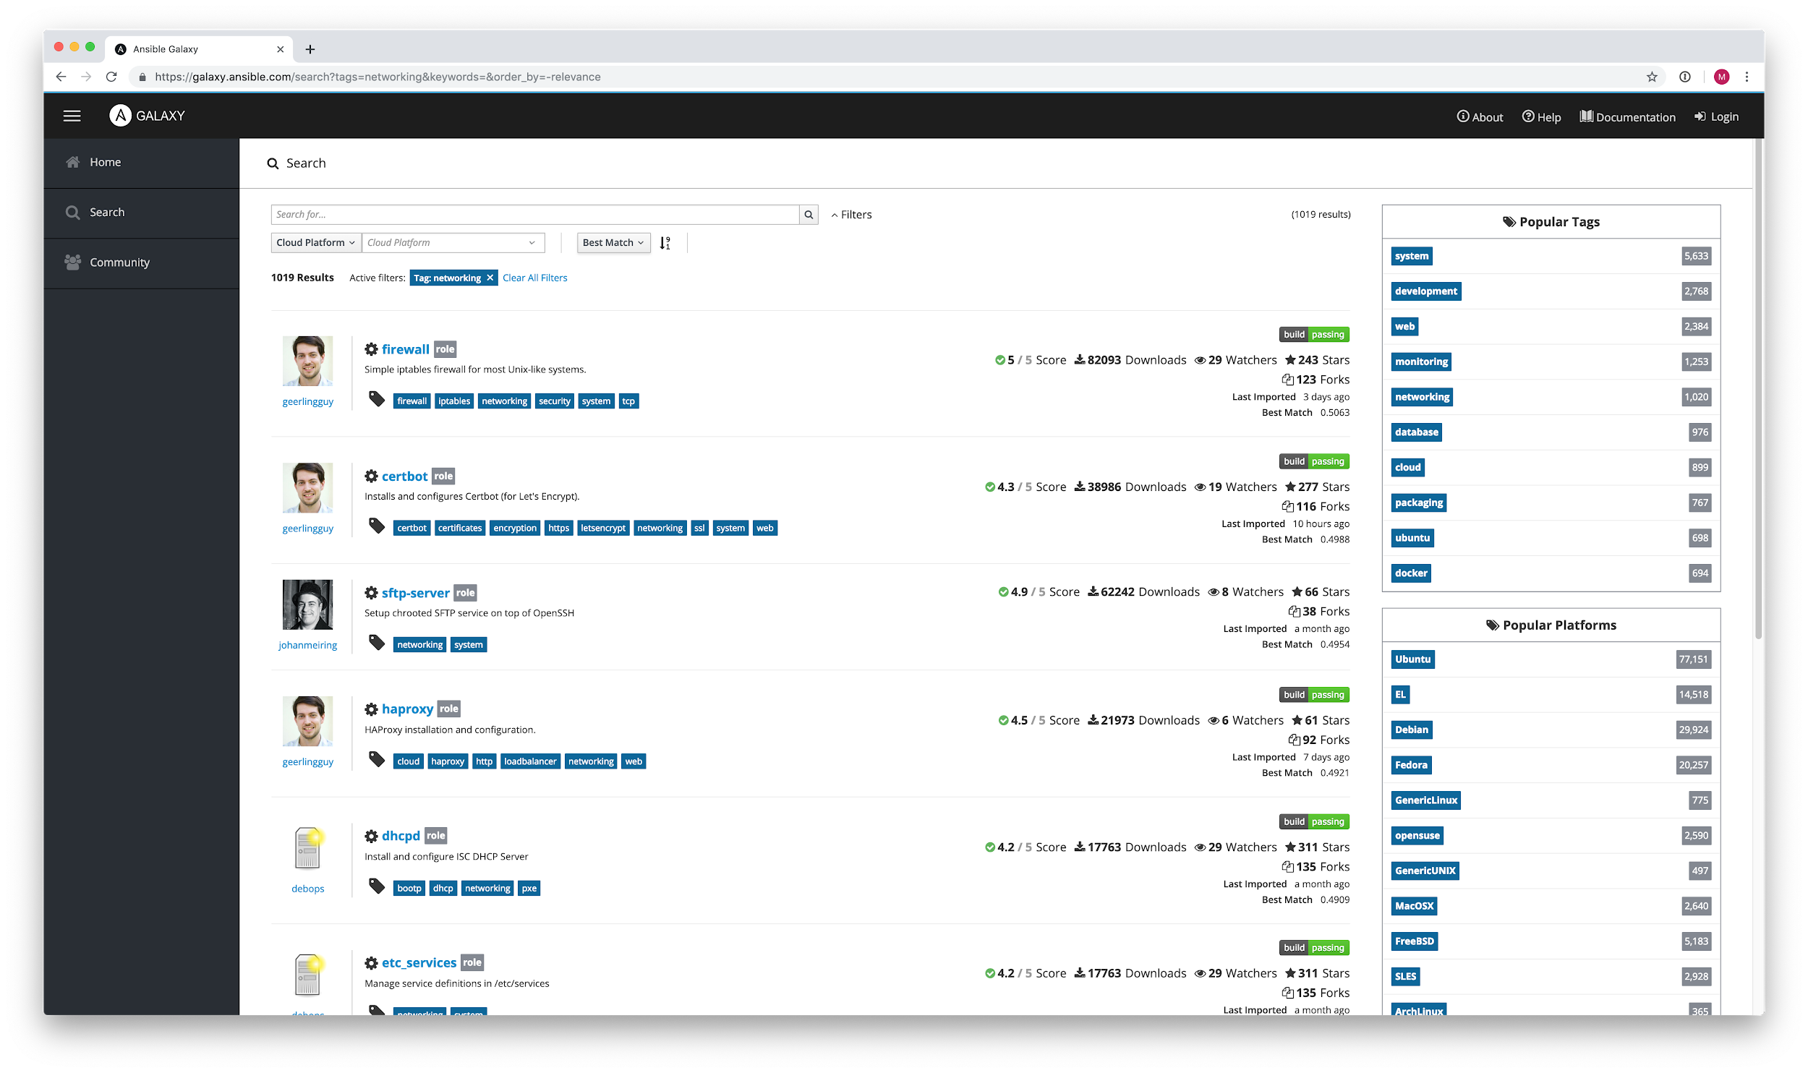
Ansible Galaxy
Notes:
There’s currently over 20 thousand roles on Ansible Galaxy. Chances are you can find one you can leverage instead of writing your own playbooks.

Slide 19
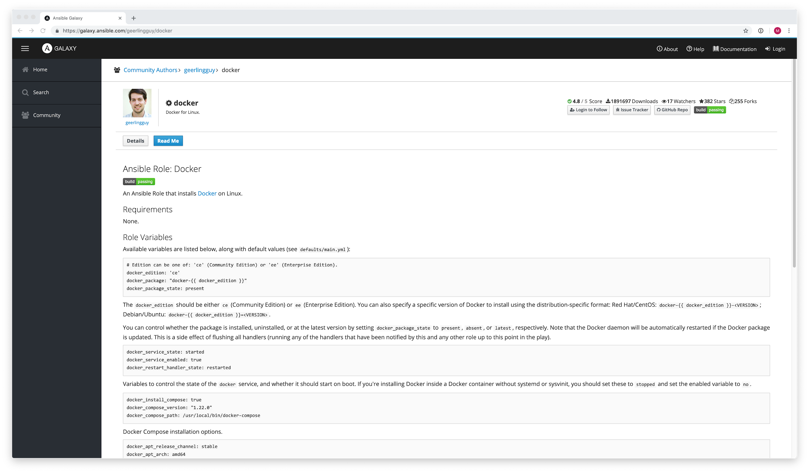
Sample Role: geerlingguy.docker
Notes:
Here’s one that I use a lot which sets up Docker on a Linux machine. Roles typically come with a number of variables so you can tweak how they run without having to modify the code yourself.

Slide 20
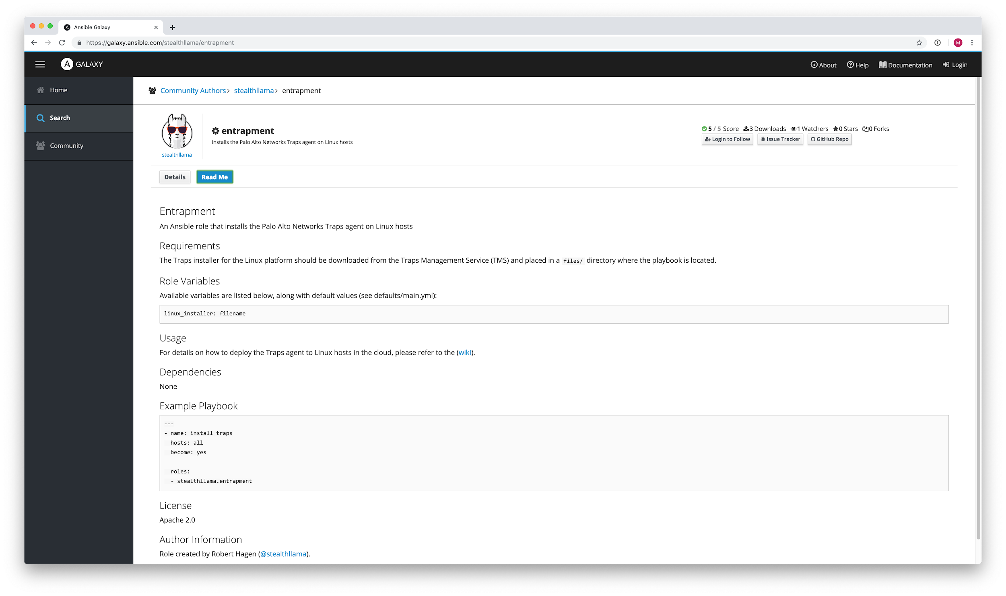
Sample Role: stealthllama.entrapment
Notes:
Here’s another example of a role to easily install Traps on Linux hosts.

Slide 21
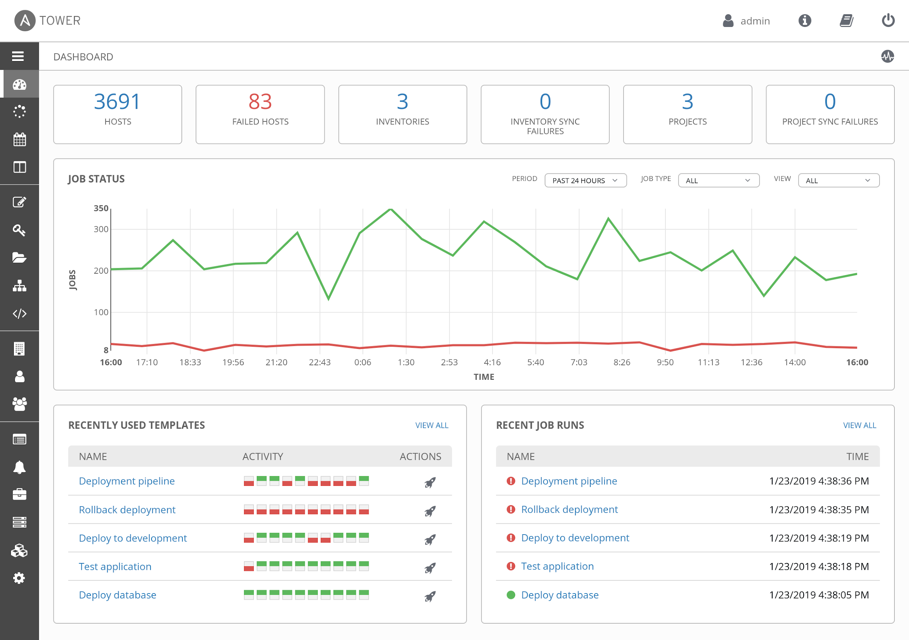
Ansible Concepts: Tower
https://www.ansible.com/products/tower
Centralized execution console and reporting for Ansible
Most likely your customer is using this
Notes:
The last thing you should know about is Ansible Tower.
Running Ansible from the command line is great for individuals and small teams, but Tower adds centralized job management, scheduled execution, role based access control, etc.
Most likely your customer is using this, so it’s good to know what it does at a high level.

Slide 22
Using Ansible with PAN-OS
Notes:
Now, let’s talk about using Ansible with PAN-OS.

Slide 23
Using Ansible with PAN-OS
Module repository: https://github.com/PaloAltoNetworks/ansible-pan
Documentation: https://paloaltonetworks.github.io/ansible-pan/
Install required Python libraries
Install modules from Ansible Galaxy
pip install pan-python pandevice
ansible-galaxy install PaloAltoNetworks.paloaltonetworks
Notes:
The source code for the Palo Alto Networks Ansible modules are published on Github. Here’s a link to the repository as well as the documentation.
In order to use them, you’ll need to install the Python libraries they’re built with. We also publish the modules on Galaxy, so installation is easy.

Slide 24
PAN-OS Ansible Modules
~50 modules, each for a specific config element
Most modules also support Panorama
Not just for VM-Series
Community maintained:
Developer Relations
Automation CE team
SEs
Customers and Partners
Most use cases have been identified, but not all
Python and pandevice make writing new modules easy
We accept pull requests!
Notes:
We currently have around 50 modules, each for a specific config element. There’s panos_address_object for address objects, panos_security_rule for security rules, and so on.
Most modules that aren’t specific to networking configuration also support Panorama.
Remember our API is consistent across both physical and virtual form factors, so these modules work with physical firewalls just like they do with VM-Series.
They’re community maintained, so if you find a bug open a GitHub issue and not a TAC case. The developer relations team does a lot of work, but some of them are maintained by the CE team, SEs, or customers/partners.
We’ve got module support for most use cases, but not all
We have great Python library support, so writing new Ansible modules is easy
If you’ve found something that the existing modules can’t do, we’d love to hear about it, or see your code!

Slide 25
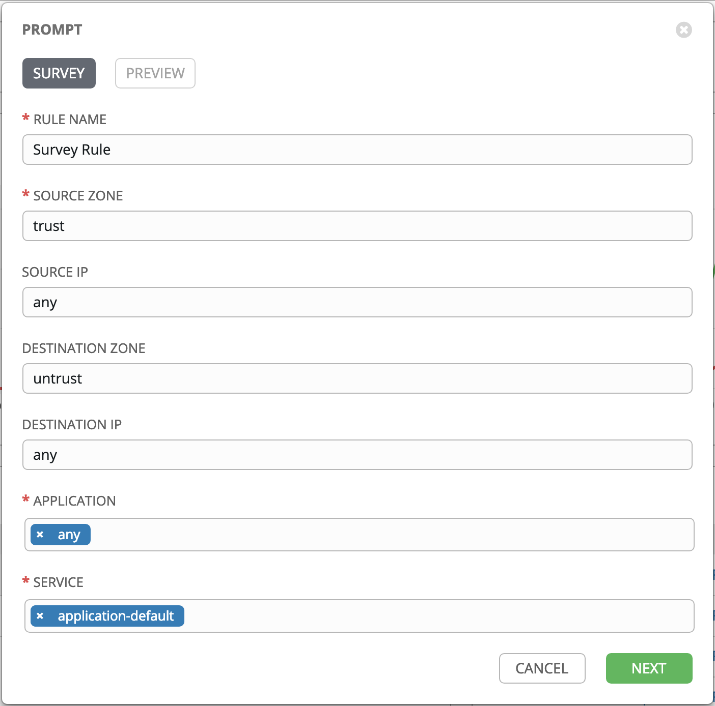
Self-Service Rule Add
https://github.com/mrichardson03/ansible-pan-samples/blob/master/fw_rule_survey.yml
Simple playbook, but the user is prompted for rule information via an Ansible Tower survey.
Notes:
So, what can you *do* with the Ansible modules? You can do almost anything you can use the API for, but you don’t actually have to know the API or write your own code. You can write rules, manipulate dynamic address groups, upgrade software, you name it.
Here’s an example of a simple playbook that adds a rule, but when it’s run from Ansible Tower you get prompted to fill out the details via a survey. Tower has role based access control that you can add in, so you have the beginnings of a basic self-service rule change system. You can even schedule the playbook to run during a change window.

Slide 26
Firewall On-Boarding
https://github.com/stealthllama/ansible-playbooks/blob/master/onboard.yml
Complete firewall onboarding process (only Panorama has access to the outside world):
Add to Panorama
License the firewall
Upgrade content
Upgrade software release
Push device group and template data
Notes:
Another great example is on-boarding a new firewall. Bob wrote a playbook to provision a firewall from scratch, even if only Panorama can access the outside world.
It:
Adds the firewall to Panorama
Retrieves the licenses from the support portal
Upgrades the content
Upgrades the software (even multiple upgrade hops), with waits for reboots
Triggers a commit from Panorama with the appropriate device group and template data

Slide 27
Value for Customers
Easily automate PAN-OS tasks using tools they are already using
Build an application’s security policy directly into the method of deployment
Notes:
In summary, you should keep in mind when talking to customers about using Ansible with PAN-OS:
That they can easily automate tasks using tools that they’re already using, and in a lot of cases without having to know our APIs or doing any custom coding.
They can build the security policy needed to support an application directly into the playbooks used to deploy it. It can be committed to source control and made part of the application itself, so it can be collaborated on and refined over time by developers and operations teams.

Slide 28
Notes:
Thanks for watching. If you’ve got more questions about Ansible, or need some help getting started, you can find us in the Automation section of Tek-talk, or on Slack in the #terraform-ansible channel.

